Slide 1

Greedy Algorithm for Decision Trees with Hypotheses

Slide 2
SYNOPSIS
INTRODUCTION TO GREEDY ALGORITHM
GREEDY ALGORITHM WITH EXAMPLE
DECISION TREE & EXAMPLE
HOW DECISION TREE USE GREEDY ALGORITHM
WHY GREEDY ALGORITHM USE DECISION TREES
APPLICATION OF DECISION TREE WITH GREEDY APPROACH
PROS AND CONS
CONCLUSION

Slide 3
GREEDY ALGORITHM WITH EXAMPLE.
A greedy algorithm is an algorithmic strategy that makes the best optimal choice at each small stage with the goal of this eventually leading to a globally optimum solution. This means that the algorithm picks the best solution at the moment without regard for consequences. It picks the best immediate output, but does not consider the big picture, hence it is considered greedy.
Locally optimal choice means what individual choice does at each step.
Global optimum is how entire system (Global optimal for entire array)
This simple, intuitive algorithm can be applied to solve any optimization problem which requires the maximum or minimum optimum result.
The best thing about this algorithm is that it is easy to understand and implement.
The runtime complexity associated with a greedy solution is pretty reasonable.

Slide 4
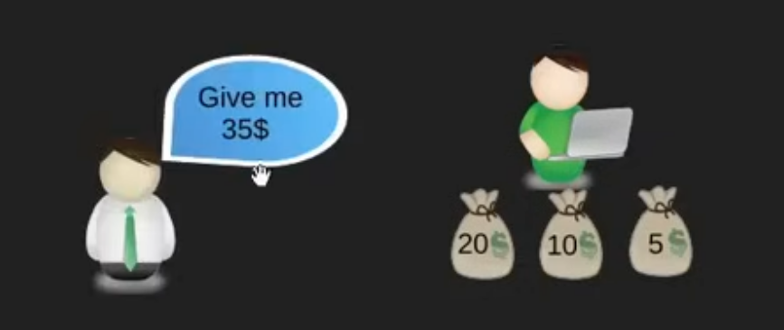
Example of greedy algorithm
We here have two person lender and borrower
So borrower ask money to lender with minimum number of coins and amount he needs is 35$.
So we see above image as he could give money in all 5$ coin and one 10$ and remaining 5$ . But here borrower needs minimum number of coins he needs greedy idea .

Slide 5
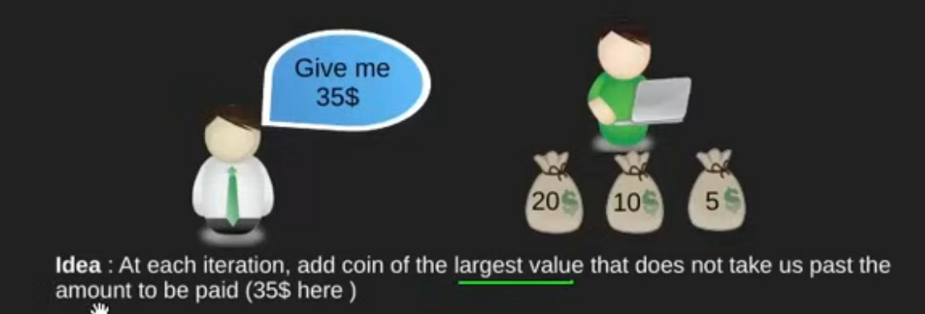
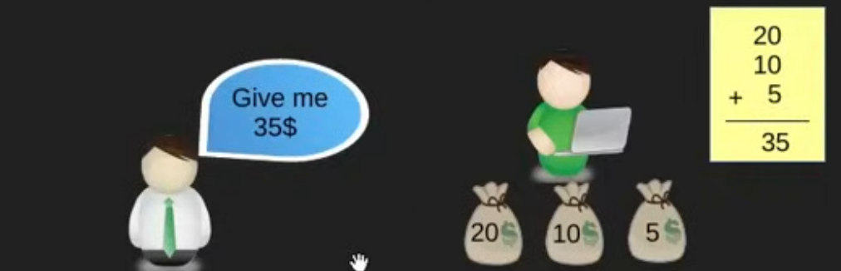
Greedy idea
Greedy idea way !
So we need largest value and it does not take past amount which is 35$
So he gave the 20 dollars and 10 dollars and 5 dollars which is only 3 coins .

Slide 6
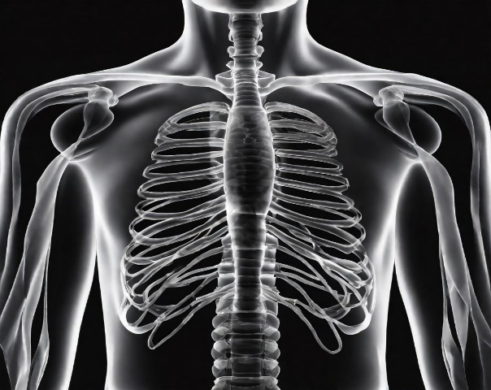
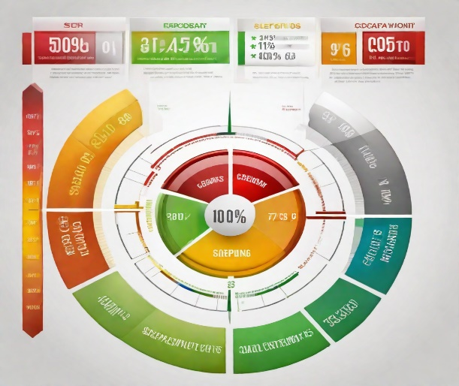
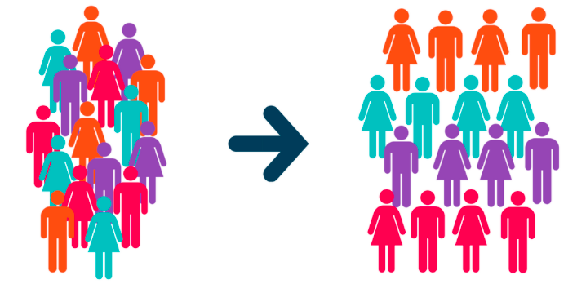
Pros and cons of greedy algorithm
Applications of greedy algorithm
Medical Diagnosis
The greedy algorithm has been used in medical diagnosis to help doctors make accurate diagnoses from X-ray images.
Credit Scoring
The greedy algorithm has been used in credit scoring to help lenders assess the creditworthiness of potential borrowers.
Customer Segmentation
The greedy algorithm has been used in customer segmentation to help businesses identify different groups of customers with similar characteristics.
Pros
Simple , easy to implement , and it runs faster.
Cons
May not always produce the optimal tree.
May not account for all relevant features.

Slide 7
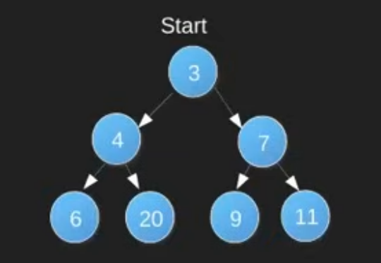
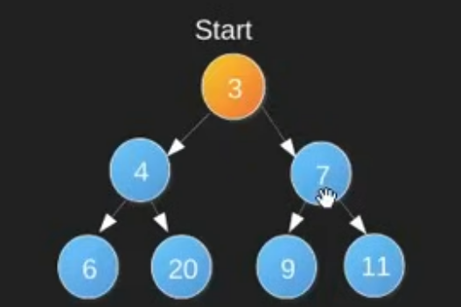
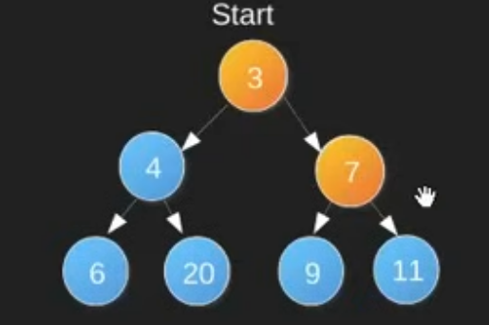
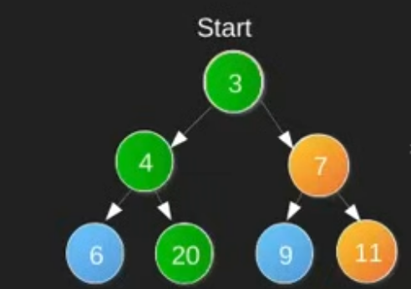
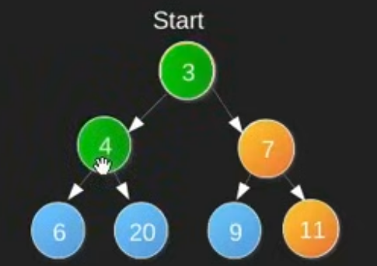
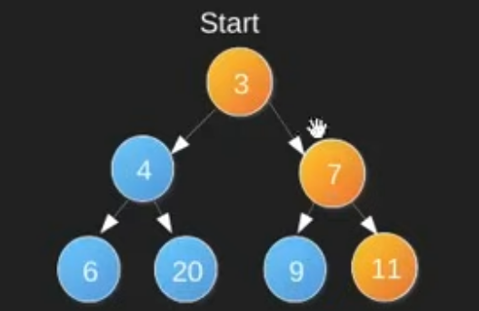
Showing example how algorithm makes locally optimal choices ending at non -optimal solution.
So here we conclude that making locally optimal greedy choices don't always gives us the globally , so when we need to use
greedy methods. Greedy choice property and optimal substructure.

Slide 8
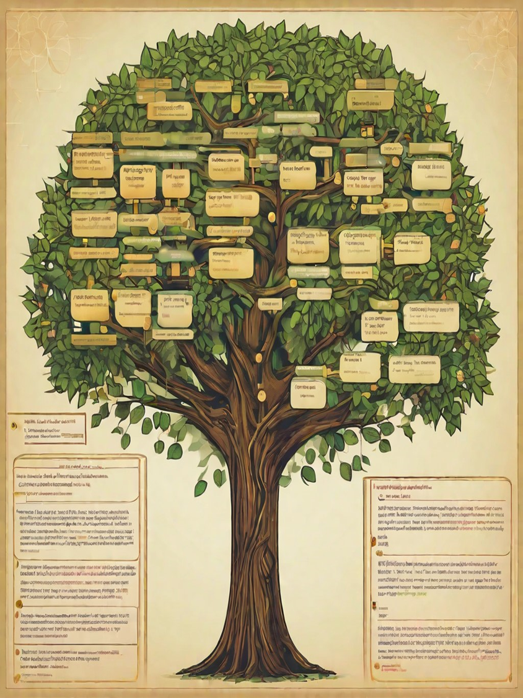
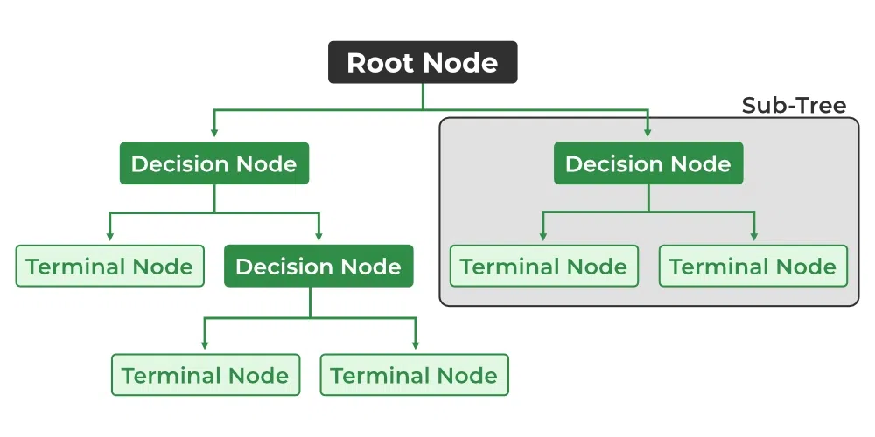
DECISION TREE
A decision tree is a non-parametric supervised learning algorithm, which is utilized for both classification and regression tasks. It has a hierarchical, tree structure, which consists of a root node, branches, internal nodes and leaf nodes.

Slide 9
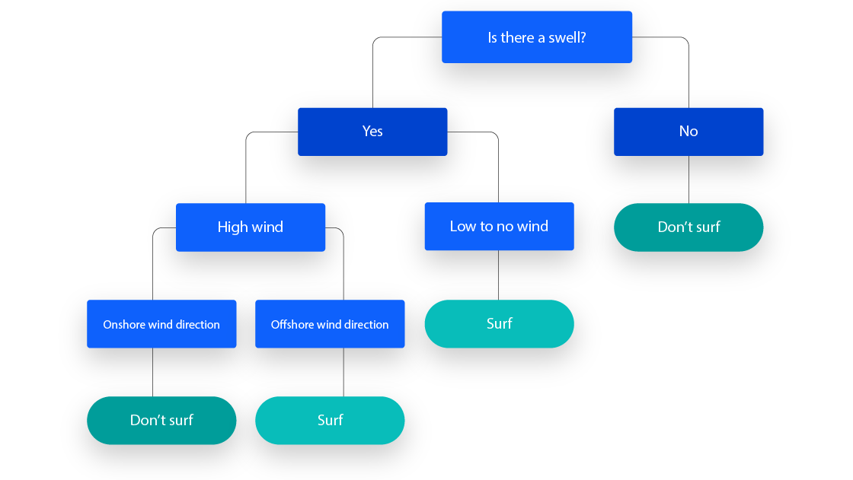
DECISION TREE WITH EXAMPLE
OUTPUT OF THE DECISION TREE WILL BE BASED ON THE INPUT

Slide 10

HOW DECISION TREE USE GREEDY ALGORITHM
So greedy algorithm for this problem might involve selecting elements one by one based on a specific criterion at each step. Let's consider a greedy algorithm that chooses the element with the highest value at each step
We can represent the decision-making process using a decision tree. At each level of the tree, the algorithm makes a decision by choosing the element with the highest value. The tree branches out based on the choices made at each step
So when greedy approach is done the best split occurs at a particular step rather than looking ahead and making a split that will result in better prediction.

Slide 11
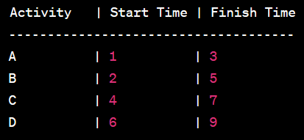
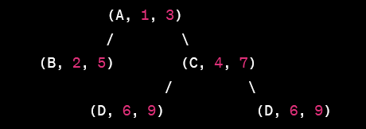
Examples Problem
Root Node: Represents the entire set of activities.
First Level: The algorithm makes a decision to include or exclude an activity based on the earliest finish time. It selects activity A with the earliest finish time of 3.
Second Level: Now, the remaining activities are B, C, and D. The algorithm selects activity B with the earliest finish time of 5.
Third Level: The algorithm continues to choose activities with the earliest finish time. At this point, it has two options: include activity C or exclude it. The decision tree shows both possibilities.

Slide 12
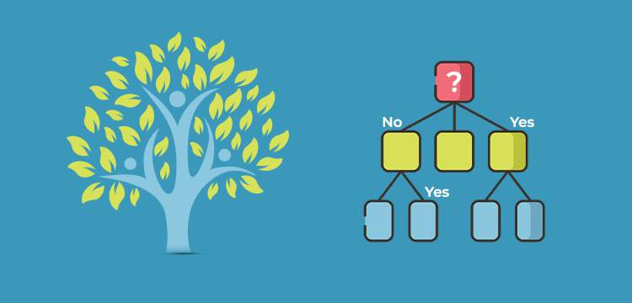
APPLICATION OF DECISION TREE WITH GREEDY APPROACH
Selection of Best Feature
Recursive Splitting
Decision Criteria
Leaf Node Assignment
Hypothesis Generation
Prediction and Inference

Slide 13
CART(Classification and Regression tree )
We are going to see the approach selection of best feature.
CART uses the greedy approach to select the feature that maximizes the information gain.
It is used for generating classification tree
It is used for binary classification
Gini index used to decrease the impurity of from the root nodes

Slide 14
APPLICATION EXPLANATION WITH CART ALGORITHM
So we have a dataset that includes information about different days and whether the soccer match is played based on weather condition.
So dataset which includes information about different days and whether soccer match is played on those days . the features are for example Outlook , Temperature humidity and wind.
Outlook - Sunny , Overcast and rainfall
Temperature - hot , cold and mild
Humidity - high and normal
Wind - Weak and strong
Decision - No and Yes
Decision are like target variables to tell whether to play or not.

Slide 15
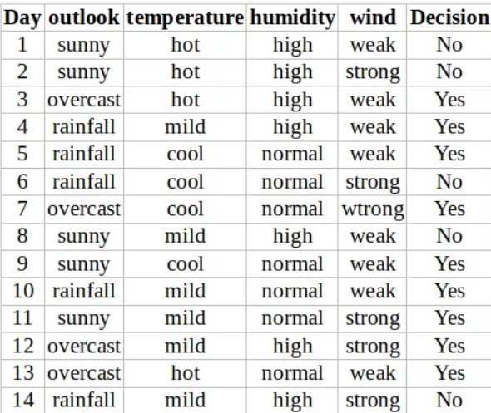
From data , outlook , temperature , humidity , wind and target is decision

Slide 16
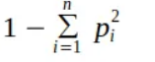
Outlook is a nominal feature and it can take three value sunny , overcast and rain , so lets summarize the final decision for outlook features.
Gini index is calculated for effective and best split from start node .
Gini index formula :
Outlook | Yes | No | Instances
Sunny | 2 | 3 | 5
Overcast | 4 | 0 | 4
Rainfall | 3 | 2 | 5

Slide 17
Gini index (outlook = sunny) = 1- (2/5)^2 - (3/5)^2 = 1 - 0.16 - 0.36 = 0.48
Gini index (outlook = Overcast) = 1 - (4/4)^2 - (0/4)^2 = 1 - 1 = 0
Gini index (outlook = rainfall ) = 1 - (3/5)^2 - (2/5)^2 = 1-0.36-0.16 = 0.48
Now we calculate the weighted sum of gini index for outlook features ,
Gini (outlook) = (5/14) * 0.48 + (4/14) * 0 + (5/14) * 0.48 = 0.342

Slide 18
Another feature which is temperature which has three values hot , cold and mild . lets summarize the final decision of temperature feature.
Gini (Temperature= hot) = 1 - (2/4)^2 - (2/4)^2 = 0.5
Gini (Temperature = cool) = 1 - (3/4)^2 - (1/4)^2 = 0.375
Gini(Temperature = Mild) = 1 - (4/6)^2 - (2/6)^2 = 0.445
Gini ( Temperature) = (4/14) * 0.5 + (4/14) * 0.375 + (6/14) * 0.445 = 0.439
Temperature | yes | no | Instances
Hot | 2 | 2 | 4
Cool | 3 | 1 | 4
Mild | 4 | 2 | 6

Slide 19
Another feature which is humidity which has three values hot , cold and mild . lets summarize the final decision of temperature feature.
Gini(Wind = weak) = 1 - (6/8)^2 - (2/8)^2 = 0.375
Gini(Wind = Strong) = 1 - (3/6)^2 - (3/6)^2 = 0.5
Gini(wind) = (8/14) * 0.375 + (6/14) * 0.5 = 0.428
Humidty | Yes | No | Instances
High | 3 | 4 | 7
Normal | 6 | 1 | 7

Slide 20
Decision for Root node
Final decision of all features
Gini index for outlook feature is lowest , so our root node is :
Tree
Features | Gini index
Outlook | 0.342
Temperature | 0.439
Humidity | 0.367
Wind | 0.428
Outlook
?
?

Slide 21
Now lets focus on sub nodes and find out gini index for temperature , humidity and wind respectively.
Day | outlook | Temperature | Humidity | Wind | Decision
1 | sunny | hot | High | weak | No
2 | sunny | mild | normal | Strong | Yes
3 | Sunny | hot | high | strong | No
4 | Sunny | Mild | high | weak | No
5 | Sunny | cool | normal | weak | Yes

Slide 22
Tables
Gini index for temperature , humidity and wind for sunny outlook.
Temperature | Yes | No | instances
Hot | 0 | 2 | 2
Cool | 1 | 1 | 1
Mild | 1 | 1 | 2
Wind | Yes | No | instances
Weak | 1 | 2 | 3
Strong | 1 | 1 | 2
Humidity | Yes | No | Instances
High | 0 | 3 | 3
Normal | 2 | 0 | 2

Slide 23
Gini Index calculations
Gini(outlook=sunny & temperature=hot) = 1-(0/2)²-(2/2)² = 0
Gini(outlook=sunny & temperature=cool) = 1-(1/1)²-(0/1)² = 0
Gini(outlook=sunny & temperature=mild) = 1-(1/2)²-(1/2)² = 0.5
Gini(outlook=sunny & temperature)= (2/5) *0 + (1/5) *0+ (2/5) *0.5 =0.2
Gini(outlook=sunny & humidity=high) = 1-(0/3)²-(3/3)² = 0
Gini(outlook=sunny & humidity=normal) = 1-(2/2)²-(0/2)² = 0
Gini(outlook = sunny & humidity) = (3/5) *0 + (2/5) *0=0
Gini(outlook=sunny & wind=weak) = 1-(1/3)²-(2/3)² = 0.44
Gini(outlook=sunny & wind=strong) = 1-(1/2)²-(1/2)² = 0.5
Gini(outlook = sunny and wind) = (3/5) *0.44 + (2/5) *0.5=0.266+0.2= 0.466

Slide 24
Decision on sunny outlook
We have calculated the Gini index of all the features when the outlook is sunny. You can infer that humidity has lowest value. so next node will be humidity.
Features | Gini Index
Temperature | 0.2
Humidity | 0
Wind | 0.466

Slide 25
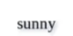
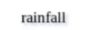
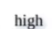
Tree
Outlook
Humidity
?
Overcast
?
?

Slide 26
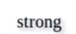
Overall tree
Lets focus on sub data for overcast outlook feature. and calculate till all dataset split is a same manner.
Tree
Outlook
Humidity
Wind
Overcast
Yes
No
No
Yes
Yes

Slide 27


Real life application of cart
Finance : Decision trees help identify potentially fraudulent transactions by analyzing patterns in financial data.
Healthcare : Decision trees assist in diagnosing medical conditions by analyzing patient data and symptoms.
CART algorithms are popular in these applications because they are interpretable, easy to understand, and provide insights into decision-making processes.

Slide 28
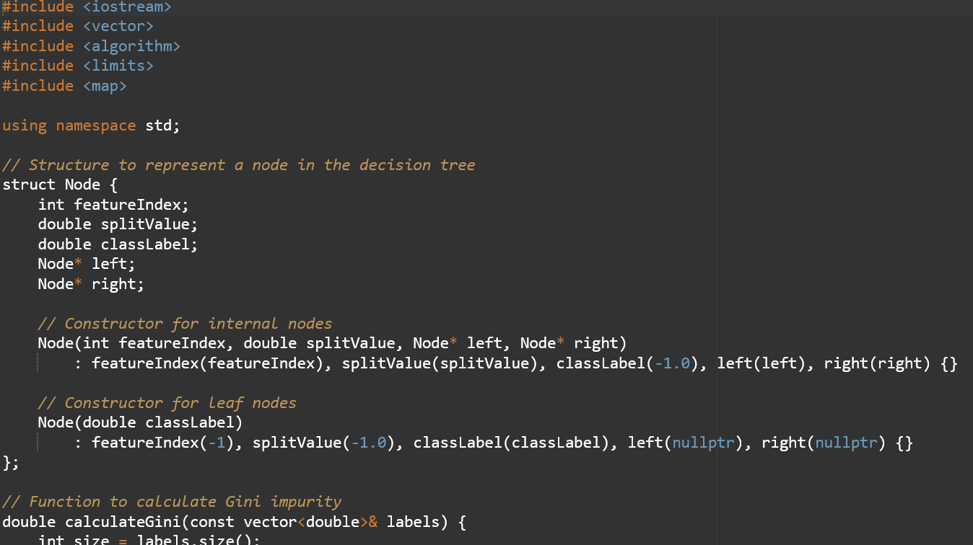
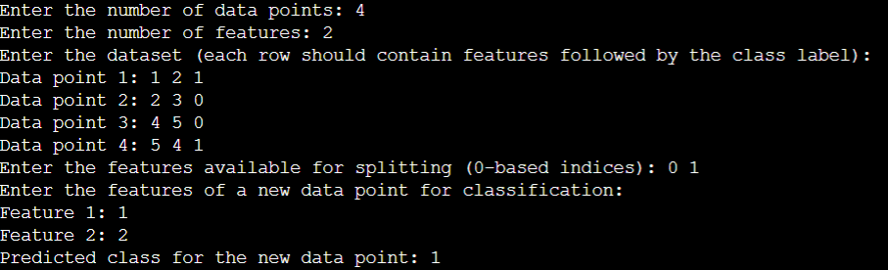
Output

Slide 29
ANY QUESTIONS?

Slide 30
THANK YOU
SIRANJEEVVENKATESWARAN( 000781648)
SHIVA PRASAD SAGAR GUNTI( 000794903)
MOUGLI POOJA RANI ( 000784790)

